Slide 1


IMDB MOVIES PROJECT
BY:
Rajendra Patil
Mohit Girdhar
Yaaz Shaikh
Akash Rathod
Om Bondfale

Slide 2
Introduction
This presentation explores the Movies & Directors database using SQL queries.
It covers key insights such as popular movies, top directors, and financial trends.

Slide 3


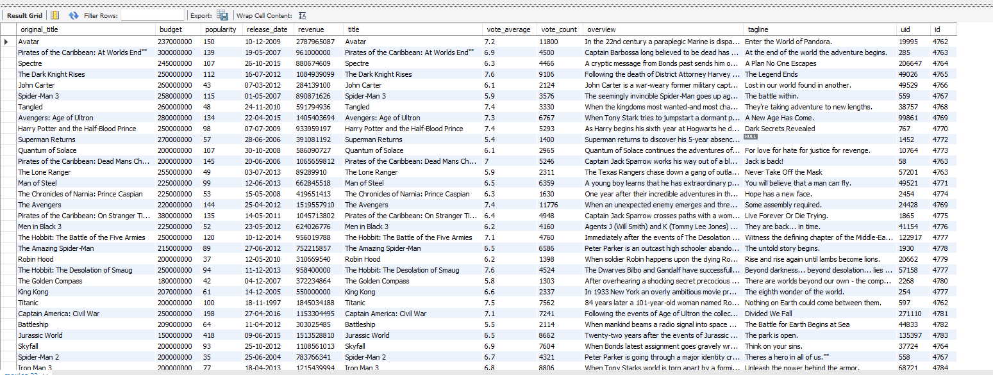
Query: Get All Movies
SQL Query:
SELECT * FROM movies;
Insight:
Retrieves all available movie data.

Slide 4
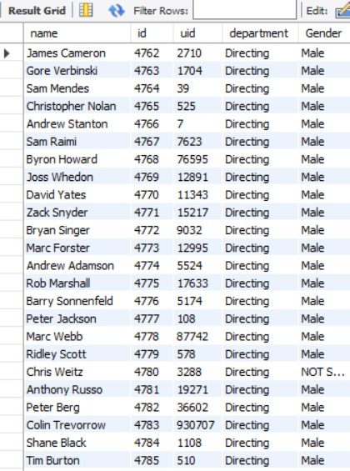
Query: Get All Directors
SELECT * FROM directors;
Insight:
Retrieves all available director data.
m directors;

Slide 5

Query: Count Movies in IMDB
SQL Query:
SELECT COUNT(*) FROM movies;
Insight:
Determines the total number of movies.

Slide 6
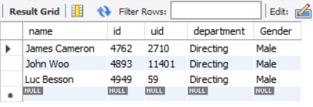
Query: Find Specific Directors
SQL Query:
SELECT * FROM directors WHERE name IN ('James Cameron', 'Luc Besson', 'John Woo');
Insight:
Finds details of specific well-known directors.

Slide 7
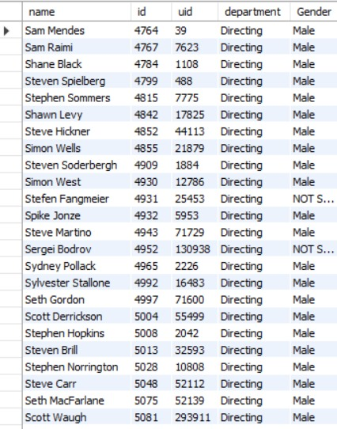
Query: Directors with Name Starting with S
SQL Query:
SELECT * FROM directors WHERE name LIKE 'S%';
Insight:
Finds directors whose names start with 'S'.

Slide 8
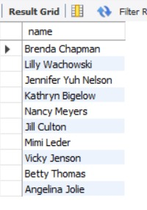
Query: Count Female Directors
SQL Query:
SELECT COUNT(*) FROM directors WHERE gender = 'Female';
Insight:
Determines the representation of female directors.

Slide 9
Query: 10th First Female Director
SQL Query:
SELECT name FROM directors WHERE gender = 'Female' ORDER BY id LIMIT 1 OFFSET 9;
Insight:
Finds the 10th first registered female director.

Slide 10
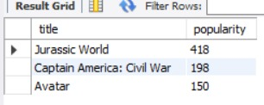
Query: Most Popular Movies
SQL Query:
SELECT title, popularity FROM movies ORDER BY popularity DESC LIMIT 3;
Insight:
Identifies the most trending movies on IMDb.

Slide 11
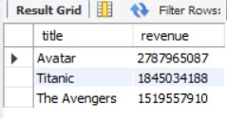
Query: Most Bankable Movies
SQL Query:
SELECT title, revenue FROM movies ORDER BY revenue DESC LIMIT 3;
Insight:
Finds the highest-grossing movies.

Slide 12

Query: Top Rated Since 2000
SQL Query:
SELECT title, AVG(vote_average) FROM movies WHERE release_date >= '2000-01-01' GROUP BY title ORDER BY AVG(vote_average) DESC LIMIT 1;
Insight:
Finds the most awarded movie since 2000.

Slide 13

Query: Movies by Brenda Chapman
SQL Query:
SELECT title FROM movies WHERE director_id = (SELECT id FROM directors WHERE name = 'Brenda Chapman');
Insight:
Finds movies directed by Brenda Chapman.
Note:
As per the Dataset no entry was present for this
Question

Slide 14
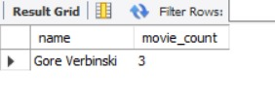
Query: Director with Most Movies
SQL Query:
SELECT director_id, COUNT(*) FROM movies GROUP BY director_id ORDER BY COUNT(*) DESC LIMIT 1;
Insight:
Finds the director who has directed the most movies.

Slide 15

Query: Most Bankable Director
SQL Query:
SELECT d.name, SUM(m.revenue) AS total_revenue FROM movies m JOIN directors d ON m.id = d.id GROUP BY d.name ORDER BY total_revenue DESC LIMIT 1;
Insight:
Finds the director generating the highest revenue.

Slide 16
Insights & Conclusion
• Certain directors consistently produce high-grossing movies.
• Female directors are underrepresented in the dataset.
• The most popular movies aren't always the most profitable.
• SQL queries help analyze industry trends effectively.

